Slide 1
Twitter sentiment analysis on Crypto Currency
- Can Twitter be used as an indicator on crypto currency value and fluctuation?
Notes:
Why this q?
The goal of this project was to apply sentiment analysis on tweets that influence the trading of cryptocurrencies.
Code is hardcoded to gather twitter data for bitcoin using keywords, but that can be easily modified to support other coins.
Cryptocurrencies have been on the rise for the past years. Their value is completely defined by speculation of how much they can be worth. As such their exchange rates are very volatile, and very unpredictable.
Twitter is one of the most popular social media networks there is, and it's an outlet through which millions of people broadcast their thoughts, fears and opinions on any topic of their interest.
The goal of this project is to determine if we can use sentiment analyzer for this publicly available data that can help predict the data.
Seemed like a good way to test our new earned skills
It’s a simple presentation since we’ve used most of our time on actual work!

Slide 2
Can Twitter be used as an indicator on crypto currency value and fluctuation?
Do not really have an answer to that!
“We know from chaos theory that even if you had a perfect model of the world, you'd need infinite precision in order to predict future events. With social media and a economic phenomena, we don't have anything like that”
(Free after Nichlas Taleb)
Notes:
BLUF:
We know from chaos theory that even if you had a perfect model of the world, you'd need infinite precision in order to predict future events. With social media and a economic phenomena, we don't have anything like that.
PROCESS
PANDAS
MATPLOTLIB
VADER
Free afternassim_nicholas_taleb_530983
Twitter sentiment analysis:
Easy and naive model:
Comparing fluctuation with sentiment score (the day before)
300 x 6 search words x 1 mnth = approx. 56000 tweets
several duplicates
language
ended upp wit approx. 9000+ ditching duplicates
The analysis would have to run all tweets for far longer than a month to surely state any basis
With all tweets (big data)
Volume of twitter messages ….
Gather BitCoin data:
CC very volatile
Through API cryptocompare.com → csv etc.
Merge dataframes
Make analysis
Correlation coefficient?
Warning! No result is also a result!!!!

Slide 3
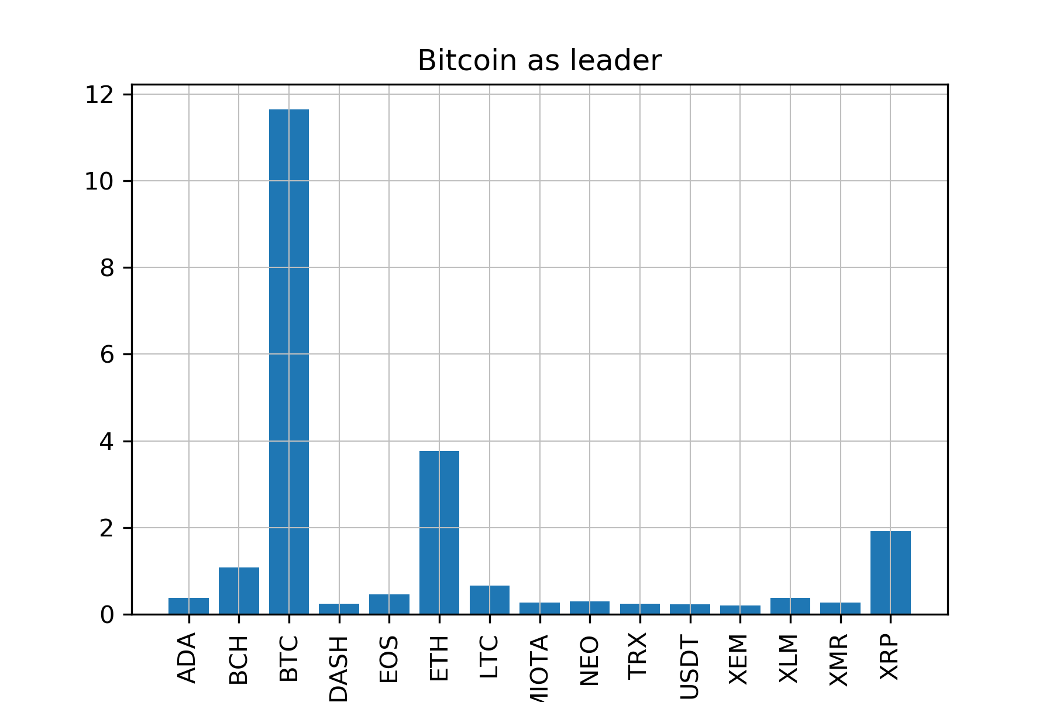
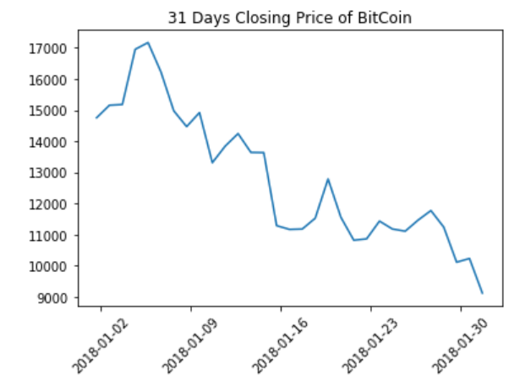
BitCoin
Why focus on BitCoin:
Amount of Twitter data where hard to gather due to restrictions in Tweepy
Needed to narrow the scope
BitCoin total market cap approx. 45% and is the most known crypto currency
Pulled data from Cryptocompare API
Historical daily average
Created csv and calculated changes
Tools used:
Python
Pandas
Numpy
Matplotlib
Notes:
Why BitCoin

Slide 4
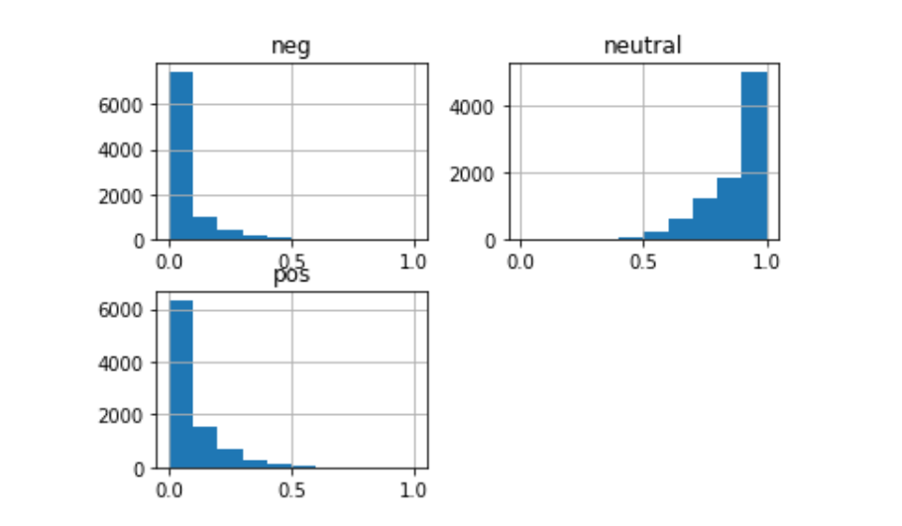
Sentiment Analysis
Pulled 300 tweets from 6 keywords daily from January
Needed cleaning, several duplicates and non english tweets
Most tweets scored high on neutral and low on either pos or neg (fig)
Big thanks to sensei Matt for digging into the code for retrieving older tweets

Slide 5
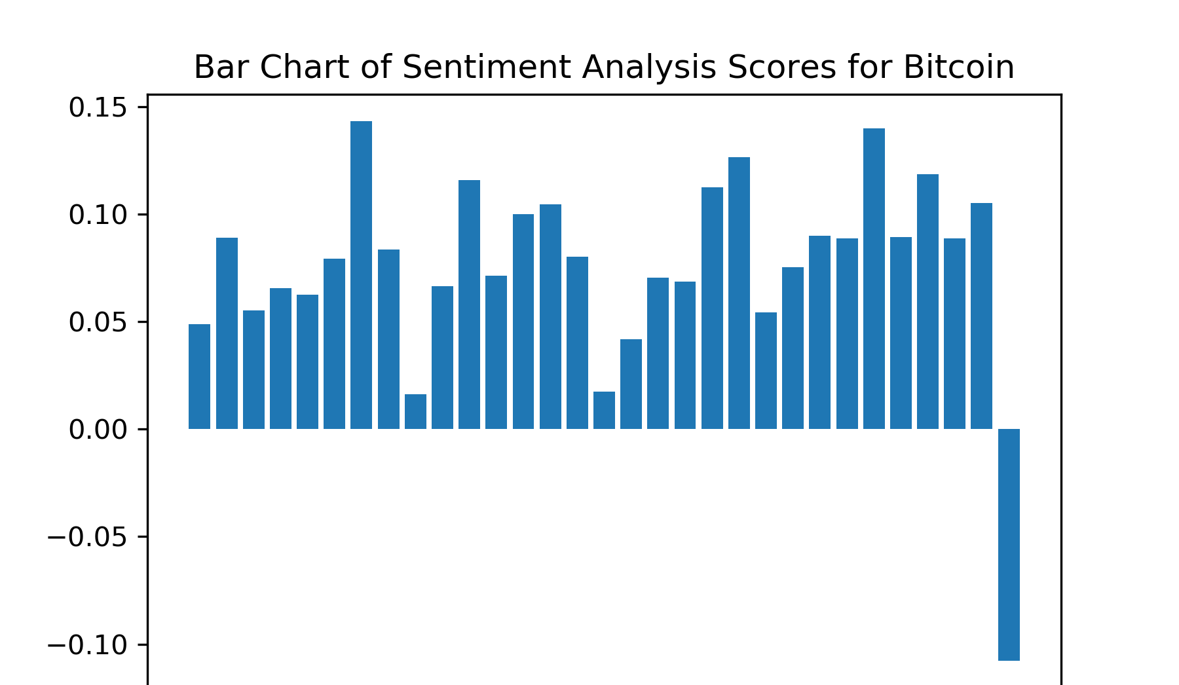
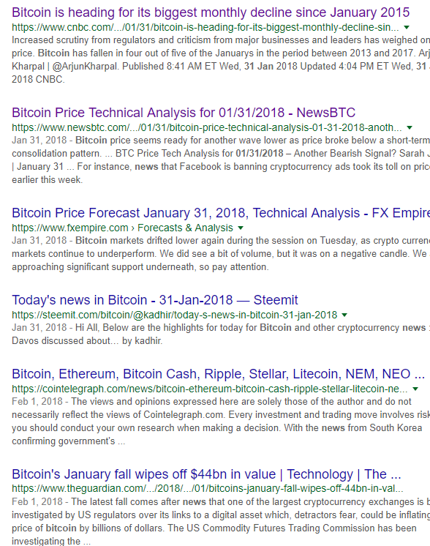
Compound score in January
Compound score from 31st of jan is the only negative
Correlates with news articles from same period

Slide 6
Lessons Learned
Overall correlation coefficient: 0,016
Indicates weak to no correlation
Due to the size of dataset we can not conclude (even if we had strong correlation)
What does it mean?
The primary conclusion is that the number of predictions were so few that venturing into prediction model conclusions would be un-founded.
From our sample, it seems like Twitter is more reactive to news in stead of being autonomous indicator of BTC status
Further improvements of the analysis would identify financial and cryptocurrency terms and yield a more representative sentiment, hopefully improving the prediction accuracy

Slide 7
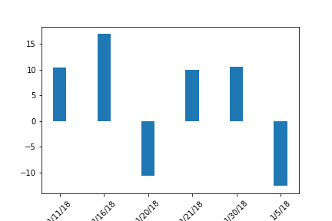

Slide 8
Twitter Sentiment Analysis
Plan for your project presentations to be 10 minutes in length.Don’t forget to describe your research questions and hypotheses.
Describe what motivated you to conduct the research that you delved into. Why are you doing this?
Describe the EDA and cleanup process.
Describe any major challenges you had.
Describe your findings. How did you arrive at your conclusions. What irrefutable evidence do you have that will crush all of your critics and enemies?Discuss the big picture implications of your findings. What does it all mean, man?
What did you learn during this process, in general? (edited)Tell a good story. Humor is welcome, but no more than 7 giphies are allowed.

